Slide 1
A study of fault tolerance in star graph
Shahram Latifi
Information Processing Letters 102 (2007) 196–200
Presenter: Chiao-Wei Chiu
Date: Feb. 27, 2008

Slide 2
Abstract
The bounds on f (n, k), the number of faulty nodes to make every (n − k)-dimensional substar (S_{n−k}) in an n-dimensional star network S_{n}, have been derived. The exact value for f (n, k) is determined when n is prime and k = 2, or when n − 2 ≦ k ≦ n. For 2 < k < n−2, a general method is presented to derive a set of faulty nodes which damage all S_{n−k}’s in S_{n}.

Slide 3
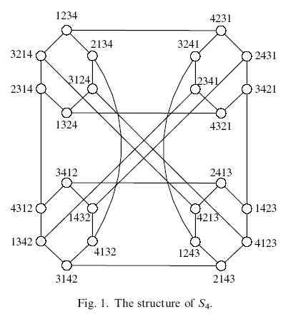
The star graph
substar XXX3
For instance, the substar X3X2X is an S₃ and contains the set of nodes {13425, 13524, 43125, 43521, 53124, 53421}.
2XX4X is not a substar S₃

Slide 4

Derivation of f (n, k)
f (n, k), the minimum number of nodes required to damage all S_{n−k}’s in S_{n}.
lower bound: 1 node fail for every disjoint S_{n−k} in S_{n}
upper bound: 1 node fail for each distinct S_{n−k}
Example n = 5, k = 2, 20 ≦ f (5, 2) ≦ 120.
  XXX35, XXX52, …
  XX42X, X3X5X, …

Slide 5
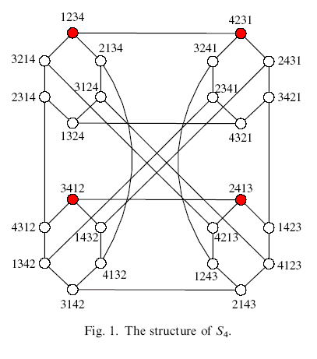
Example

Slide 6
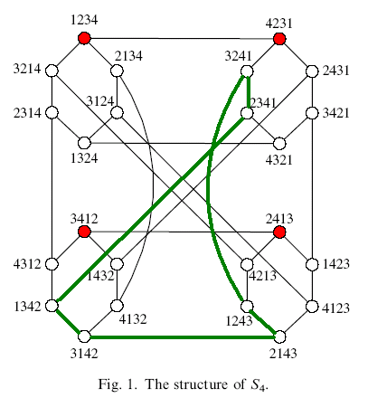
Example
substar XX4X

Slide 7
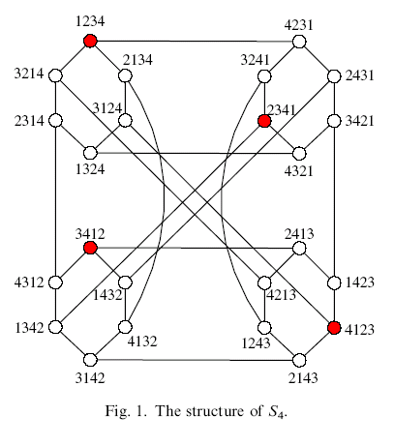
Special cases
f (n, 0) = 1
f (n, 1) = n
  The labels of these nodes are (123 . . . n) and its cyclic permutations
  For example, the set of faulty nodes {12345, 23451,34512, 45123, 51234} will destroy all S₄’s in S₅.
f (n, n-2) = n!/2
f (n, n-1) = n!
(1234) and its cyclic permutations

Slide 8
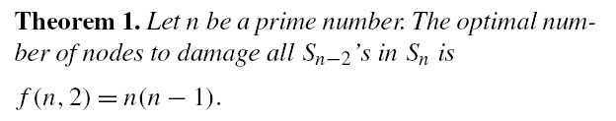
Derivation of f (n, 2)
n is a prime
Example (Derivation of f (5, 2)).
We select 4 nodes (1, 1+I, 1+2I, 1+3I, 1+4I) where all additions are mod 5, and 1 ≦ I ≦ 4.
Specifically, the set of nodes selected are: {(12345),(13524), (14253), (15432)}.
Each of these nodes is then rotated cyclically to generate 5 distinct permutations.

Slide 9
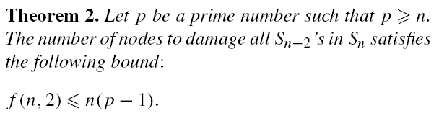
Derivation of f (n, 2)
n is not a prime
Example (Derivation of f (4, 2)).
(1234−), (13−24), (142−3), (1−432)
1234, 2341, 3412, 4123,
1324, 3241, 2413, 4132,
1423, 4231, 2314, 3142,
1432, 4321, 3214, 2143.
However, the set is not optimal (f_{optimal}(4, 2) = 12).

Slide 10
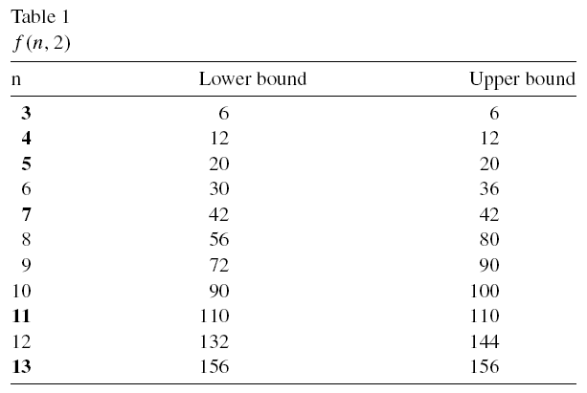
The value of f (n, 2)

Slide 11
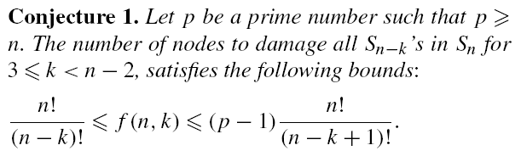
Derivation of f (n,k) for 2 < k < n−2
for n = 5 and k = 3.
The leader nodes: (12345), (13524), (14253), (15432).
for (12345) -> {(12345), (23451), (34512),(45123), (51234)}.
for (23451) -> {(23451), (24513), (25134), (21345)}.
(with its first digit fixed)

